Slide 1

Lariat Business Analysis, 2018
Presented to: Stakeholders
Presented by: Jacob Carter

Slide 2
Business Objectives
Minimizing cost and maximizing revenue for Lariat.
How to make smarter business decisions.
Analyze the costs and revenue generated by the fleet in order to derive insights and recommendations.

Slide 3
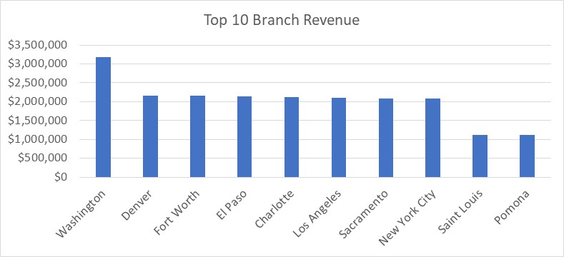
Lariat Performance 2018
Total Cars: 4000
Profit per Car: $13,207.55
Avg Price per Day: $162
Total Revenue: $52,830,207.00
Total Costs: $30,320,297.92
Total Profit: $22,509,909.08

Slide 4
Business Recommendation Options
Decreasing the volume of low performing cars, while increasing the volume of high performing cars.
Increase the total rental price for every vehicle.
Combine a higher volume of high performing cars with a higher rental price.

Slide 5
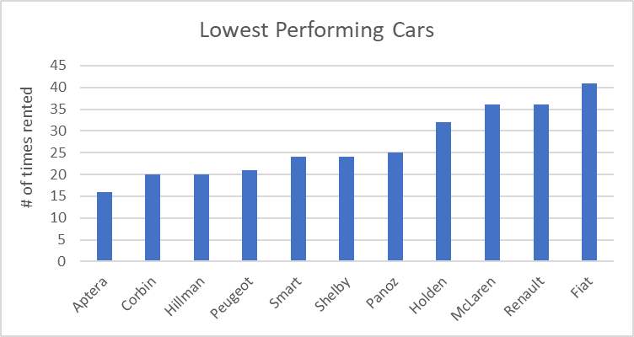
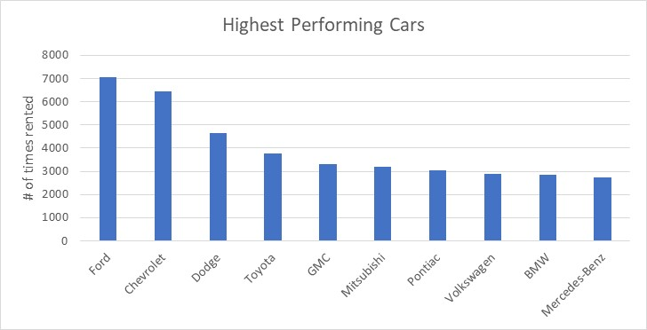
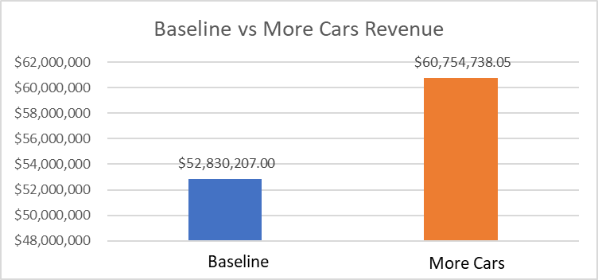
Option 1: More High Performing Cars
By decreasing the volume of lower performing cars, you can cut costs.
Most of the lower performing vehicles are luxury cars, which can be replaced for higher performing cars that cost less to maintain.
By increasing the total amount of high performing cars to 4600, revenue will increase by $7,924,531.05.

Slide 6
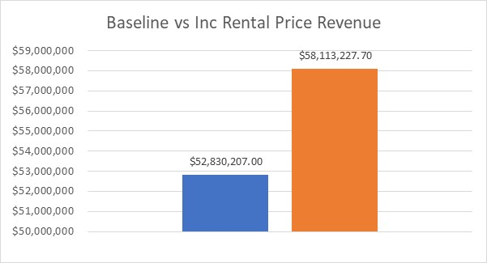


Option 2: Increase Rental Price
By increasing the rental price of every vehicle by 10%, the average price per day increases from $162 to $178. This increases total revenue by $5,283,020.70.

Slide 7
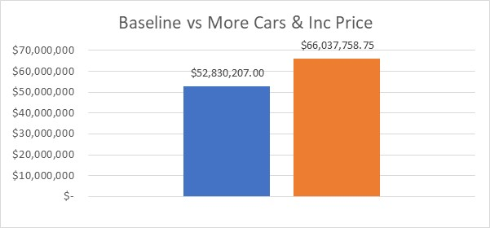

Option 3: More Cars & Higher Rental Price
By combining the first two options together, revenue will increase.
For this example, the number of high performing cars is increased to 4600, while the average price per day is increased by 10%, from $162 to $178. Revenue will increase by $13,207,551.75

Slide 8
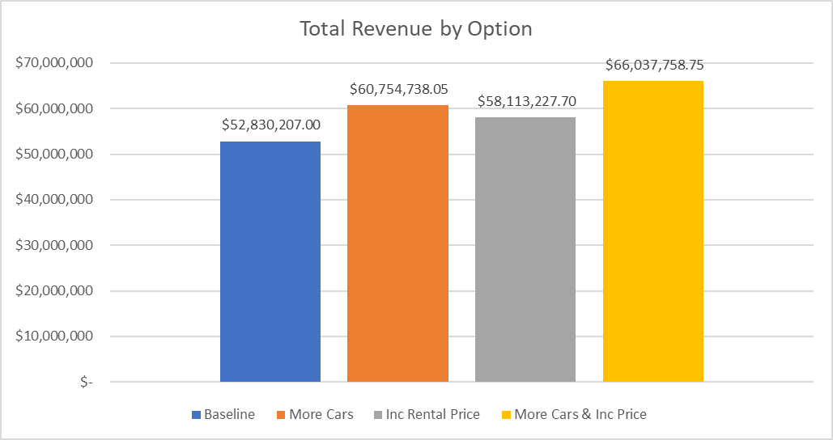
Total Revenue by Option

Slide 9
Call to Action
After analyzing the data, I recommend implementing option 3, adding more high performing cars and increasing the rental price by 10%.
You could also implement just one option and still see an increase in revenue.
I do not recommend not choosing any option because revenue will not be maximized.

Slide 10
Thank you
Questions?

